Slide 1
Rigel Engine
Reimplementing an old DOS game in modern C++

Slide 2
The game: Duke Nukem II

Slide 3
Duke Nukem II
Released: Dec. 1993
Free shareware version (¼ of full content)
Paid full version ($ 35)
System requirements:
286 CPU (386 recommended)
560 KB RAM
MS-DOS 3.3
VGA-compatible video card
Optionally supported:
Soundblaster + AdLib sound cards
Joysticks
http://www.mobygames.com/images/covers/l/21879-duke-nukem-ii-dos-front-cover.jpg

Slide 4
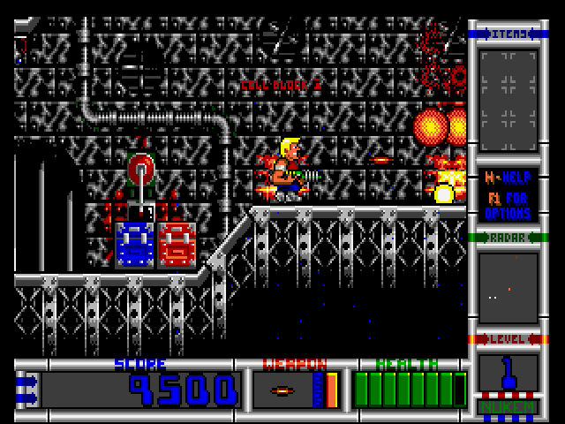
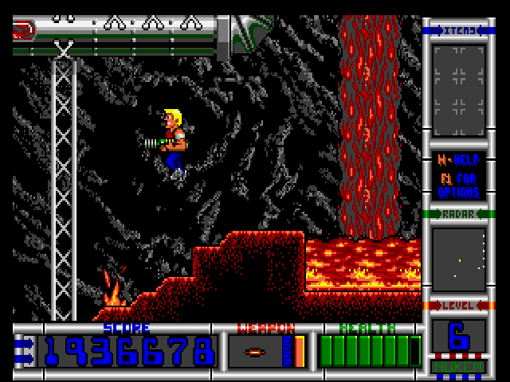
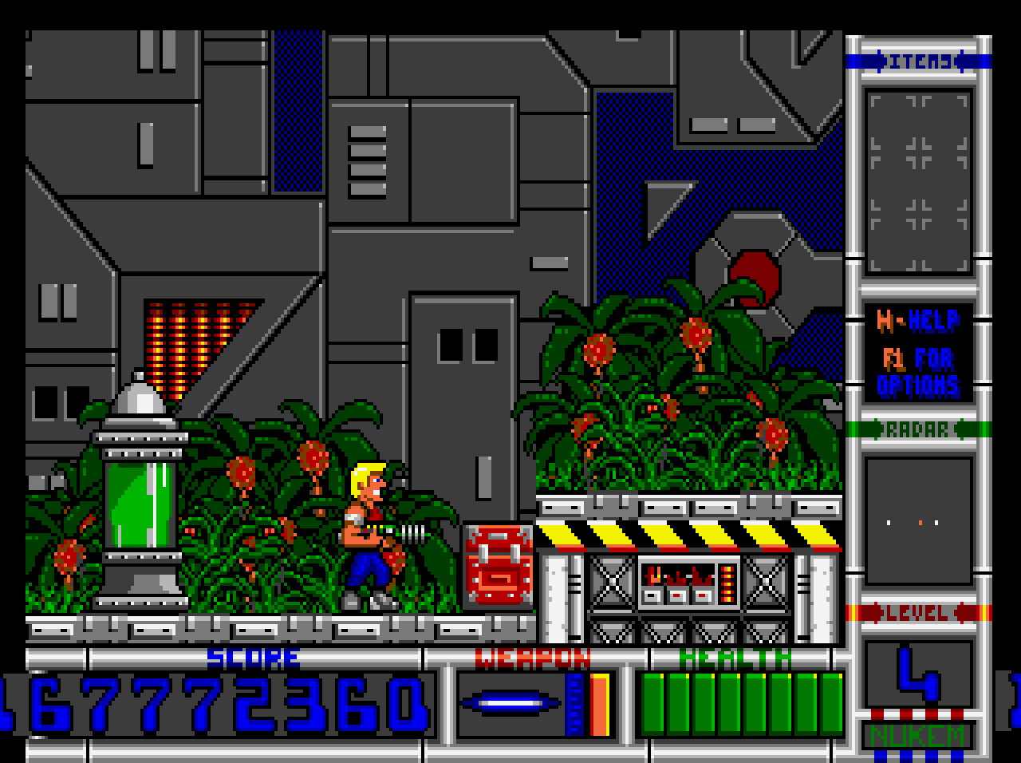
Duke Nukem II
Size on disk (executable + data):
3.4 MB (shareware)
5.7 MB (full version)
Audio/video output:
320x200 screen resolution (stretched to 4:3 by CRT)
16 color palette (256 for intro movies)
17.5 FPS (70 Hz ÷ 4)
Monoaural sound output
No mixing (only 1 sound effect at a time)

Slide 5
Hardware of the time

Slide 6
CPUs
80286 (1982)
Clock speed: 4 to 12.5 MHz, later 20 to 25 MHz
At 12 MHz: ~2.66 MIPS
No L1/L2 cache
Only 16-bit registers
No floating point (unless co-processor installed)
https://en.wikipedia.org/wiki/Intel_80286#/media/File:Intel_80286_die.JPG

Slide 7
CPUs
80386 (1985)
Clock speed: 12 to 40 MHz
At 33 MHz: ~9.9 MIPS
Optional cache (out-of-chip)
80486 (1989)
On-chip cache, improved pipelining, integrated floating point unit
Clock speed: 20 to 66 MHz, 100 MHz
At 50 MHz: ~40 MIPS
https://en.wikipedia.org/wiki/Intel_80386#/media/File:KL_Intel_i386DX.jpg

Slide 8
VGA Graphics
First release: 1987
(min.) 256 KB VRAM
16 or 256 color palettes
Common resolutions:
640x480
640x350
640x200
320x200
http://www.vgamuseum.info/images/palcal/cirrus/
669_vga-cl34_w_cirrus_logic_cl-5434-hc-d_top_hq.jpg

Slide 9
AdLib and Sound Blaster sound
AdLib (1987)
Add-on card with FM synthesizer chip
Intended for music, but can do some sounds
Sound Blaster (1989), Sound Blaster Pro (1991)
Full compatibility to AdLib
Includes the same synthesizer chip
Additional support for digitized sound playback
8-bit, 22.05 kHz (44.1 kHz on SB Pro)
http://www.mediafire.com/convkey/44ba/4qwdgeqjuummj35zg.jpg?size_id=a

Slide 10
The project: Rigel Engine

Slide 11
What is Rigel Engine?
2D game engine based on OpenGL and Entity-Component-Systems
Code to read assets (data) from original game’s files
Graphics, sounds, music
Maps/level data
Implementation of original game logic/enemy behaviors etc.
Based on reverse-engineering
All written in modern C++

Slide 12
What is it not?
An emulator*
Logic is completely re-implemented in native code
Recreating the original source code/architecture
Aiming for equal behavior, but very different architecture under the hood
Able to run on the original hardware
Being free of the (very tight) constraints is part of the fun
An editor/file extraction tool
There are many projects for that already
* Emulation is used to play back music

Slide 13
Advantages of a modern re-implementation
No emulator necessary – fully native
More responsive controls
Shorter loading times
Proper gamepad/controller support
Possibility for enhanced graphics and sound
Software preservation – source code allows:
Porting to future platforms
Bug fixes
Enhanced modding support

Slide 14
Similar projects
https://davidgow.net/keen/omnispeak.html
Omnispeak is an open-source reimplementation of Commander Keen episodes 4, 5, and 6. It aims to be a pixel-perfect, bug-for-bug clone of the original games, and is compatible with savegames from the DOS version.
http://clonekeenplus.sourceforge.net/
Commander Genius is a software piece that interprets the Commander Keen Invasion of the Vorticons and Galaxy series. As fans and developers, we are, we try to implement new features, improve the gameplay, and give players an experience that feels like playing the original game but a bit more refreshing.

Slide 15
Quick project overview
C++ 14 (migration to 17 planned)
~ 16,700 LOC (1.2k LOC tests)
GPL v2
CMake
CI via Travis CI/AppVeyor

Slide 16
Quick project overview
OpenGL 3.0 (or ES 2.0)
SDL (http://www.libsdl.org/)
Boost (optional, variant, program options, signals2)
EntityX (https://github.com/alecthomas/entityx)
DBOPL AdLib emulator (from DosBox, https://www.dosbox.com/)

Slide 17
Project evolution
First commit: 21 Aug 2016 (On GitHub: 22 Oct)
831 commits (584 on GitHub)
Pause: April/May till end of August (4-5 mo)
Total time worked on: 9-10 months

Slide 18
Implementation progress (Shareware only)
13/24 enemies
14/29 game mechanics
6/15 non-ingame features

Slide 19
Implemented enhancements
Concurrent sound effects
No loading screens
More responsive controls (still WIP)
Removed limitations
Max number of particles
Max number of explosions, debris and other effects
Notes:
Original game’s limits: 5*64 particles, 18 effect sprites, 6 player projectiles

Slide 20
Supported platforms
Windows (MSVC 2015)
Linux (Clang 3.9, GCC 5.4)
Mac OS X (AppleClang 8.0.0)
Raspberry Pi (GCC 5.4 for ARM)

Slide 21
Live Demo!

Slide 22
Reverse Engineering the original

Slide 23
Reverse engineering techniques
Observing the original
Stepping through video captures
Building custom levels for testing
Reading the assembly

Slide 24
Stepping through video captures
ffmpeg -i nukem2_051.avi -r 17.5 f%000d.png
https://upload.wikimedia.org/wikipedia/commons/d/dd/DOSBox_icon.png
https://openclipart.org/detail/29273/movie-reel
Notes:
I play the game in DosBox, and DosBox has a video capture feature.

Slide 25
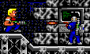
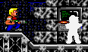

Stepping through video captures

Slide 26
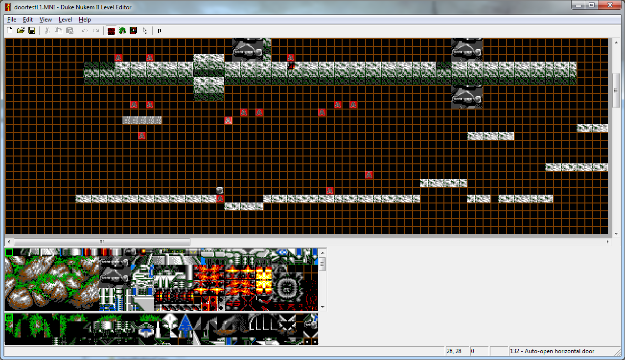
Building custom levels for testing

Slide 27
Disassembling with Ida Pro
Ida Pro – The interactive disassembler
Features:
Visualize control flow as graph
Assign names to function parameters, variables, functions etc.
Define struct layouts
Jump to cross-references
Version 5 free for non-commercial use:
https://www.hexrays.com/products/ida/support/download_freeware.shtml

Slide 28
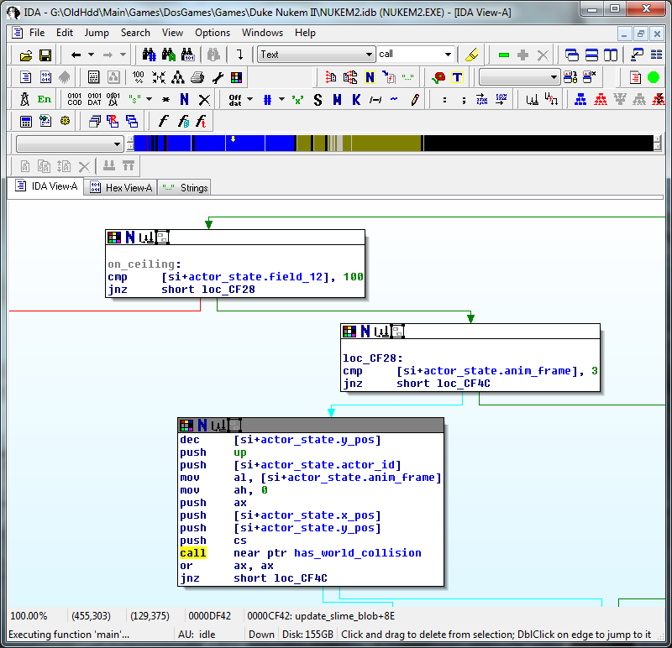
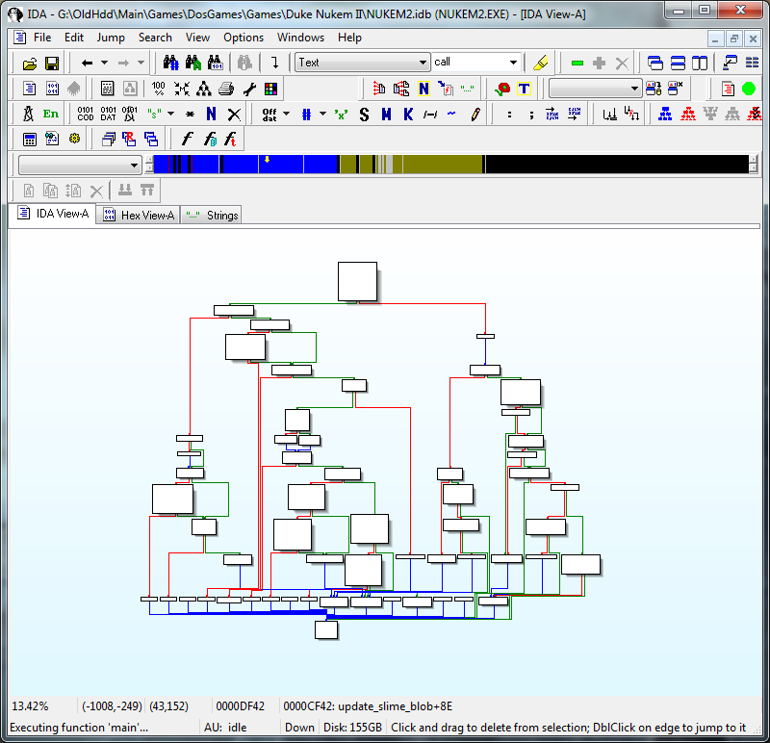

Slide 29
Notes:
To explain:
Named struct members
Named constant
Named function
Then, if I were to double click the function, it would take me to the graph view for that function.

Slide 30
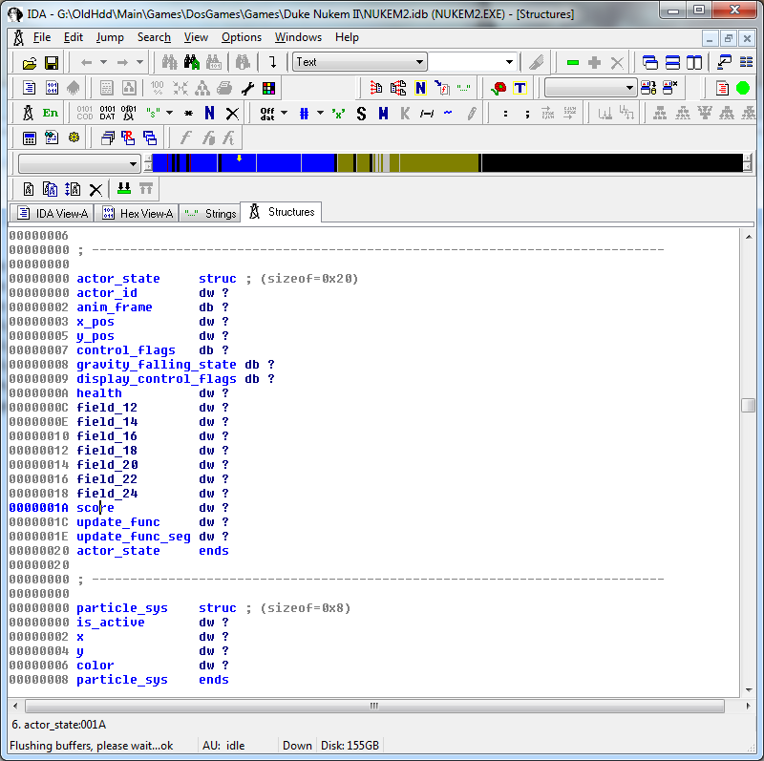

Slide 31
Disassembling: Workflow
Open graph for function
Make sure known names/definitions etc. are applied
Transcribe assembly into C-like pseudo-code
Simplify pseudo-code, identify underlying logic
C++ implementation

Slide 32
const int UP = ...;
if (state->field_12 != 100) {
if (state->anim_frame == 3) {
--state->y_pos;
if (has_world_collision(
UP,
state->actor_id,
state->anim_frame,
state->x_pos,
state->y_pos)
) {
// ...
}
}

Slide 33
Disassembling: It’s not that bad!
Limited instruction set (16-bit real-mode)
Original source code was in C
Old compilers didn’t optimize as aggressively
Mostly simple logic
Call well-known functions (collision checking, projectile spawning etc.)
Increment counters/animation frame index
Branch based on counter state

Slide 34
C++ goodies

Slide 35
C libraries and std::unique_ptr
SDL_Window* SDL_CreateWindow(…);
void SDL_DestroyWindow(SDL_Window* window);
SDL_Texture* SDL_CreateTexture(…);
void SDL_DestroyTexture(SDL_Texture* texture);
// etc...
Notes:
SDL is a classic C library – it provides factory functions and deleter functions for all types

Slide 36
C libraries and std::unique_ptr
Using unique_ptr’s “deleter” argument
auto pWindow = std::unique_ptr<SDL_Window, void(*)(SDL_Window*)>{
SDL_CreateWindow(...), SDL_DestroyWindow};
Notes:
Can’t use make_unique here

Slide 37
Determining the right deleter
template<typename SDLType>
struct DeleterFor {};
template<>
struct DeleterFor<SDL_Window> {
static auto deleter() { return &SDL_DestroyWindow; }
};
template<>
struct DeleterFor<SDL_Texture> {
static auto deleter() { return &SDL_DestroyTexture; }
};
template<typename SDLType>
auto deleterFor() { return DeleterFor<SDLType>::deleter(); }
Notes:
In C++ 17, this will be even easier thanks to constexpr if

Slide 38
Defining a Ptr template
template<typename SDLType>
using PtrBase = std::unique_ptr<SDLType, void(*)(SDLType*)>;
template<typename SDLType>
class Ptr : public detail::PtrBase<SDLType> {
public:
template<typename P>
Ptr(P&& p)
: detail::PtrBase<SDLType>(std::forward<P>(p), deleterFor<SDLType>())
{}
Ptr() : Ptr(nullptr) {};
};

Slide 39
Client code with helper class
auto pWindow = std::unique_ptr<SDL_Window,
void(*)(SDL_Window*)>{
SDL_CreateWindow(...), SDL_DestroyWindow};

Slide 40
Client code with helper class
auto pWindow = Ptr<SDL_Window>{SDL_CreateWindow(...)};

Slide 41
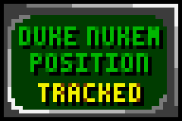

Palette-based graphics
16 color palette
need 4 bit per pixel
2 pixels per byte
Notes:
Image: 48x32

Slide 42
Planar memory layout
Bank A
Bank B
Bank C
Bank D
8, 13, 13, 12

Slide 43
Planar memory layout
Bank A
Bank B
Bank C
Bank D
8, 13, 13, 12
1
0
0
0
8 → 1000₂

Slide 44
Planar memory layout
Bank A
Bank B
Bank C
Bank D
8, 13, 13, 12
1, 1
0, 1
0, 0
0, 1
8 → 1000₂
13 → 1101₂

Slide 45
Planar memory layout
Bank A
Bank B
Bank C
Bank D
8, 13, 13, 12
1, 1, 1, 1
0, 1, 1, 1
0, 0, 0, 0
0, 1, 1, 0
8 → 1000₂
13 → 1101₂
13 → 1101₂
12 → 1100₂
Notes:
70 Hz * 320px * 200px → ~18 Mbit/s

Slide 46
Original graphics format
Linear:
10001101₂, 11011100₂, 11001101₂, 11011000₂
Planar:
11111111₂, 01111110₂, 00000000₂, 01100110₂

Slide 47
Decoding the game’s graphics files
Required: Reading single bits
for (int bit = 7; bit >= 0; --bit) {
const auto bitMask = 1 << bit;
const auto valueOfBit = value & bitMask;
// work with valueOfBit
}

Slide 48
Decoding the game’s graphics files
Wanted: Abstract away the bit-wrangling, write algorithm in terms
of “sequence of values”
Solution: Create adapter iterator

Slide 49
Adapter iterator: bit-wise reading
template<typename OriginalIterType>
class BitWiseIterator {
public:
// some boilerplate omitted
explicit BitWiseIterator(OriginalIterType originalIter) :
mOriginalIter(originalIter), mBitIndex(0) {}
// comparison operators, post-fix increment operator omitted
BitWiseIterator& operator++();
bool operator*() const;
private:
OriginalIterType mOriginalIter;
std::uint8_t mBitIndex;
};

Slide 50
Adapter iterator: bit-wise reading
BitWiseIterator& operator++() {
++mBitIndex;
if (mBitIndex == 8) {
++mOriginalIter;
mBitIndex = 0;
}
return *this;
}
bool operator*() {
const auto actualBitIndex = 7 - mBitIndex;
const auto bitMask = 1 << actualBitIndex;
const auto bitPack = *mOriginalIter;
return (bitPack & bitMask) != 0;
}

Slide 51
Adapter iterator: Client code
vector<uint8_t> decodedIndices(numPixels, 0);
BitWiseIterator<ByteBufferCIter> bitsIter(dataBegin);
for (auto plane = 0; plane < 4; ++plane) {
auto destination = begin(decodedIndices);
for (auto pixel = 0; pixel < pixelCount; ++pixel) {
const auto planeBit = *bitsIter++;
*destination++ |= planeBit << plane;
}
}

Slide 52


State machines for enemy AI: Example
Flying
Hovering
Plunging down
Rising up

Slide 53
Red bird state machine
Flying
Hovering
Position over player
Original height reached
Timeout elapsed
Rising
Plunging
Ground hit

Slide 54
”Old-school” approach
enum class BirdState {
Flying, Hovering, Plunging, Rising
};
struct RedBird {
BirdState mState;
int mOriginalHeight;
int mElapsedTime;
};
switch (bird.mState) {
case BirdState::Flying:
// Check if over player
break;
case BirdState::Hovering:
// etc.
Notes:
Disadvantage: Not clear which variables belong to which state

Slide 55
Encoding states in a variant<>
struct Flying {};
struct Hovering { int mFramesElapsed = 0; };
struct PlungingDown { int mInitialHeight; };
struct RisingUp { int mInitialHeight; };
using StateT = variant<
Flying, Hovering, PlungingDown, RisingUp>;
struct RedBird {
StateT mState;
};

Slide 56
Pattern matching on the state
atria::variant::match(birdState.mState,
[&](const Flying&) {
const auto wantsToAttack =
position.y + 2 < playerPosition.y && position.x > playerPosition.x &&
position.x < playerPosition.x + 2;
if (wantsToAttack) {
birdState.mState = Hovering{};
}
},
[&](Hovering& state) {
++state.mFramesElapsed;
if (state.mFramesElapsed >= 6) {
birdState.mState = PlungingDown{position.y};
}
},
// etc. for remaining states

Slide 57
Other uses for variant pattern matching
Script interpreter
Parse text into command objects
Script →
Game mode management (ingame vs. bonus-screen)
Effect specification DSL
std::vector<variant<Command1, Command2, ...>>;
const EffectSpec SPIDER_KILL_EFFECT_SPEC[] = {
{EffectSprite{{-1, 1}, 1, EffectMovement::None}, 0},
{RandomExplosionSound{}, 0}
};
const EffectSpec RED_BIRD_KILL_EFFECT_SPEC[] = {
{Particles{{}, INGAME_PALETTE[5]}, 0},
{EffectSprite{{}, 1, EffectMovement::None}, 0},
{RandomExplosionSound{}, 0}
};

Slide 58
Pattern matching in C++
Library-based (https://github.com/Ableton/atria, others)
C++ Weekly Ep. 49: Inheriting lambdas to make a combined visitor
Proposal to add native pattern matching to C++: P0095
Rant about std::visit: https://bitbashing.io/std-visit.html

Slide 59
Entity-Component-Systems

Slide 60
Motivation: Provide more flexibility than OOP
class GameObject {
public:
virtual void update(float timeDelta);
};
class Game {
private:
vector<unique_ptr<GameObject>> mObjects;
public:
void updateGame(const float timeDelta) {
for (auto& pObject : mObjects) {
pObject->update(timeDelta);
}
}
};

Slide 61
GameObject
Renderable
PhysicalBody
StaticObject
AIControllable
EnvironmentalHazard
EvilMonster
FieryFire

Slide 62

“Can we have a monster that’s also on fire?”
Notes:
This is a contrived example, of course, but game programmers face real problems like this. This usually leads to either overly big base classes, because everything that’s required in mutliple branches of the inheritance tree gets stuffed in there, or frequent restructuring of hierarchies to accommodate new requirements becomes necessary, increasing the development effort significantly.

Slide 63
Entity, Component, System
Component
Holds state, POD-like
Entity
Handle/ID for a set of components
System
Implements logic for combination of components

Slide 64
Example components
Position
x, y, z
Renderable
vertices, textures
DamageInflictor
damageAmount, affectedGroups
BoundingBox
minX, minY, minZ,
maxX, maxY, maxZ
ItemPickup
givenItemType
PhysicalBody
velocity, acceleration

Slide 65
Example entities
Player
Decoration
Monster
Position
Position
Position
Renderable
Renderable
AI state
Bounding Box
DamageInflictor
...
Renderable

Slide 66
Systems
Implement specific logic for certain combination of components
Can read and write components’ data
Only operate on entities with required components
Can send and receive events from/to other systems/outside world

Slide 67
Example systems
PhysicsSystem - needs Position, PhysicalBody
// update position component
position += physicalBody.velocity;
// update velocity
physicalBody.velocity += physicalBody.acceleration * dt;

Slide 68
Example systems
CollisionDetectionSystem - needs Position, BoundingBox
const auto candidates = possibleColliders();
const auto it = find_if(begin(candidates), end(candidates),
[&](const auto& collider) {
return intersecting(collider.bbox, bbox);
});
if (it != end(candidates)) {
emitEvent(Collision{*it, currentEntity});
}

Slide 69
Example systems
Rendering system – needs Renderable, Position, BoundingBox
AI controller system – needs AiState, Position
Sound emitter system – needs Sound, Position
etc.

Slide 70
Component storage
Entity 0
Entity 1
Entity 2
Entity 3
Entity 4
Position pool
Position
Position
Position
Position
Position
Visuals pool
Visuals
Visuals
Visuals
Bounds pool
Bounds
Bounds
Bounds
Bounds
Sound pool
Sound

Slide 71
Composition at runtime
auto entity = entityManager.createEntity();
entity.addComponent<Position>(Position{3, 5});
entity.addComponent<AIState>(AIState{ai::Type::SmartMonster});
auto gameMap = loadMap();
for (const auto& description : gameMap.enemies()) {
auto enemy = entityManager.createEntity();
enemy.addComponent<Position>(description.position);
enemy.addComponent<VisualRepresentation>(
createVisualsForEnemyType(description.type));
}

Slide 72
Behavior as combination of systems
Example: Projectile
Movement handled by PhysicsSystem
Collision checked by CollisionDetectionSystem
Inflicts damage on enemy via DamageInflictionSystem
Visual representation handled by RenderingSystem

Slide 73
ECS libraries for C++
EntityX (https://github.com/alecthomas/entityx)
A fast, type-safe C++ Entity-Component system
ECST (https://github.com/SuperV1234/ecst)
Experimental & work-in-progress C++14 multithreaded compile-time Entity-Component-System header-only library.
EnTT (https://github.com/skypjack/entt)
EnTT is a header-only, tiny and easy to use Entity-Component System in modern C++

Slide 74
ECS in Rigel Engine

Slide 75
case 19: // Rocket launcher
{
CollectableItem item;
item.mGivenScore = 2000;
item.mGivenWeapon = WeaponType::Rocket;
configureItemBox(
entity,
ContainerColor::Green,
100,
item);
}
break;
case 50: // teleporter
case 51: // teleporter
entity.assign<AnimationLoop>(1);
entity.assign<Interactable>(InteractableType::Teleporter);
entity.assign<BoundingBox>(BoundingBox{{2, 0}, {2, 5}});
break;

Slide 76
void IngameSystems::update(const PlayerInputState& inputState, entityx::EntityManager& es) {
mRenderingSystem.updateAnimatedMapTiles();
engine::updateAnimatedSprites(es);
engine::markActiveEntities(es, *mpScrollOffset);
mpPlayerModel->updateTemporaryItemExpiry();
mElevatorSystem.update(es, inputState);
mPlayerMovementSystem.update(inputState);
mPlayerInteractionSystem.update(es);
mBlueGuardSystem.update(es);
mHoverBotSystem.update(es);
mLaserTurretSystem.update(es);
mMessengerDroneSystem.update(es);
mNapalmBombSystem.update(es);
mPrisonerSystem.update(es);
mRedBirdSystem.update(es);
mRocketTurretSystem.update(es);
mSecurityCameraSystem.update(es);
mSimpleWalkerSystem.update(es);
mSlidingDoorSystem.update(es);
mSlimeBlobSystem.update(es);
mSlimePipeSystem.update(es);
mSpikeBallSystem.update(es);
mPhysicsSystem.update(es);
mPlayerAttackSystem.update();
mPlayerDamageSystem.update(es);
mDamageInflictionSystem.update(es);
mEffectsSystem.update(es);
mPlayerAnimationSystem.update(es);
mPlayerProjectileSystem.update(es);
mMapScrollSystem.update();
mLifeTimeSystem.update(es);
mParticles.update();
}

Slide 77
ECS: My experience
Very easy to use (with a good library)
Encourages code reuse/generic behaviors
Encourages more “declarative” coding
Explicit update order is very useful
Solutions can be less obvious at first
Needs some „getting used to”

Slide 78
Funny hacks and trivia

Slide 79
(Not so random) random numbers
int random_number() {
static uint8_t index = 0;
++index;
return RANDOM_NUMBER_TABLE[index];
}

Slide 80
(Not so random) random numbers
const std::array<int, 256> RANDOM_NUMBER_TABLE{
0, 8, 109, 220, 222, 241, 149, 107, 75, 248, 254, 140, 16, 66, 74, 21, 211, 47,
80, 242, 154, 27, 205, 128, 161, 89, 77, 36, 95, 110, 85, 48, 212, 140, 211,
249, 22, 79, 200, 50, 28, 188, 52, 140, 202, 120, 68, 145, 62, 70, 184, 190,
91, 197, 152, 224, 149, 104, 25, 178, 252, 182, 202, 182, 141, 197, 4, 81, 181,
242, 145, 42, 39, 227, 156, 198, 225, 193, 219, 93, 122, 175, 249, 0, 175, 143,
70, 239, 46, 246, 163, 53, 163, 109, 168, 135, 2, 235, 25, 92, 20, 145, 138,
77, 69, 166, 78, 176, 173, 212, 166, 113, 94, 161, 41, 50, 239, 49, 111, 164,
70, 60, 2, 37, 171, 75, 136, 156, 11, 56, 42, 146, 138, 229, 73, 146, 77, 61,
98, 196, 135, 106, 63, 197, 195, 86, 96, 203, 113, 101, 170, 247, 181, 113, 80,
250, 108, 7, 255, 237, 129, 226, 79, 107, 112, 166, 103, 241, 24, 223, 239,
120, 198, 58, 60, 82, 128, 3, 184, 66, 143, 224, 145, 224, 81, 206, 163, 45,
63, 90, 168, 114, 59, 33, 159, 95, 28, 139, 123, 98, 125, 196, 15, 70, 194,
253, 54, 14, 109, 226, 71, 17, 161, 93, 186, 87, 244, 138, 20, 52, 123, 251,
26, 36, 17, 46, 52, 231, 232, 76, 31, 221, 84, 37, 216, 165, 212, 106, 197,
242, 98, 43, 39, 175, 254, 145, 190, 84, 118, 222, 187, 136, 120, 163, 236, 249
};

Slide 81
Clock deviation due to timer interrupt
Timer interrupt (INT 8): https://en.wikipedia.org/wiki/Intel_8253
Regular frequency: 18.2 Hz
Default handler: Advance time-of-day, time-out floppy disk drive, …
Game reprograms timer to approx. 280 Hz
invokes original handler every 15th time
280 / 18.2 ≈ 15,385
280 / 15 ≈ 18.6 → clock runs ≈ 2.5 % faster → 10 hrs game ≈ 15 min offset

Slide 82
Thanks for listening!

Slide 83
https://github.com/lethal-guitar/RigelEngine

